Slide 1
Analysing Airline Review Using NLP
SUBMITED BY:
KRUPAL RAJ
SHAUN S ABRAHAM
DARREN BERT LYNGDOH
MESHACH MOHANRAJ
EDWARD JEBRAJ

Slide 2
Objective
The main objective of our project is to analyze the reviews given by users and categorize them using AI algorithms into either positive or negative reviews.
We also need to provide a UI wherein we can enter our own review and the AI application will predict its outcome and display the required result as either a positive or a negative review.

Slide 3
Problem statement
There is an exponential amount of text data pertaining towards user airline reviews and manual analysis of such abundant data is extremely exhausting hence we utilize the use of AI algorithms such as Natural Language Processing(NLP) and Artificial Neural Networks(ANN) to analyze the reviews and give a suitable prediction of whether its a positive or negative review.

Slide 4
Data collection and Data preprocessing
Data preprocessing is a data mining technique that involves transforming raw data into an understandable format. Real-world data is often incomplete, inconsistent, and/or lacking in certain behaviors or trends, and is likely to contain many errors. Data preprocessing is a proven method of resolving such issues.
Steps in Data Preprocessing:
Step 1 : Import the libraries
Step 2 : Import the data-set
Step 3 : Check out the missing values
Step 4 : See the Categorical Values
Step 5 : Splitting the data-set into Training and Test Set

Slide 5
NLP
Step 1: Sentence Segmentation
Step 2: Word Tokenization
Step 3: Predicting Parts of Speech for Each Token
Step 4: Text Lemmatization
Step 5: Identifying Stop Words

Slide 6
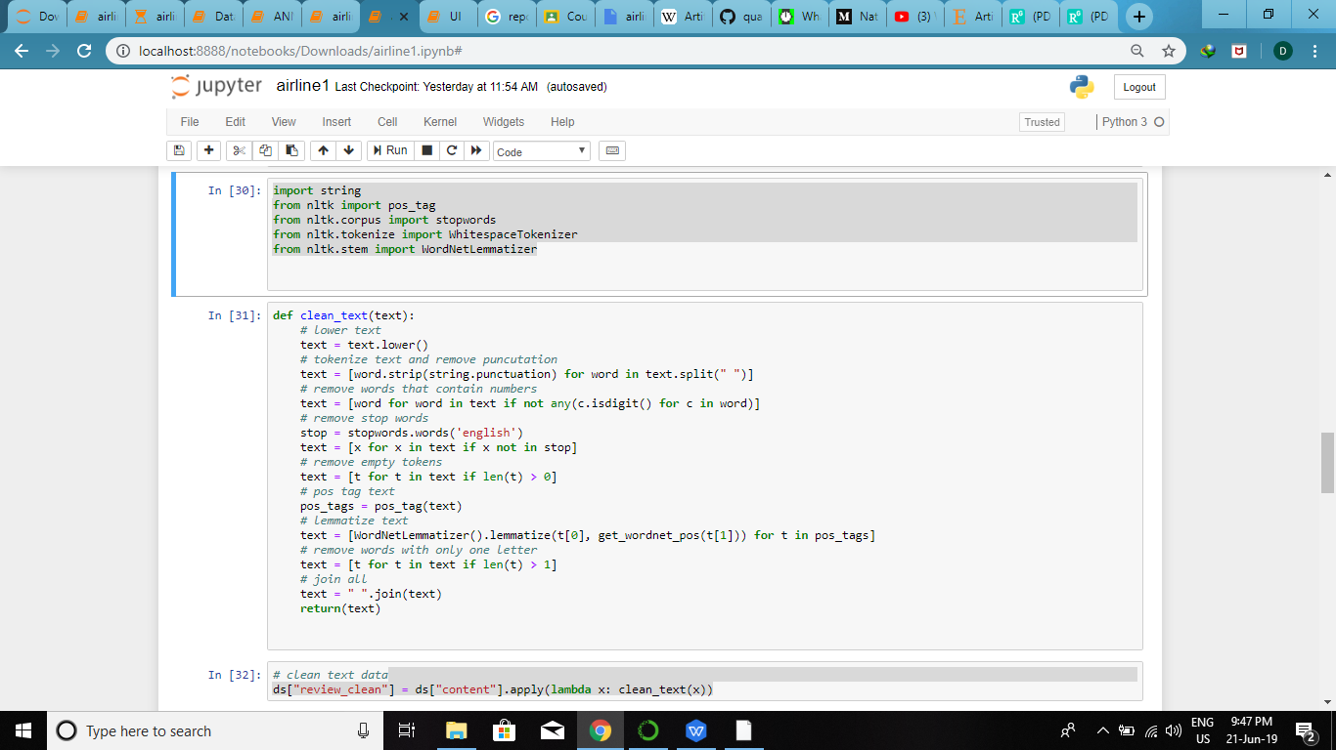
NLP

Slide 7
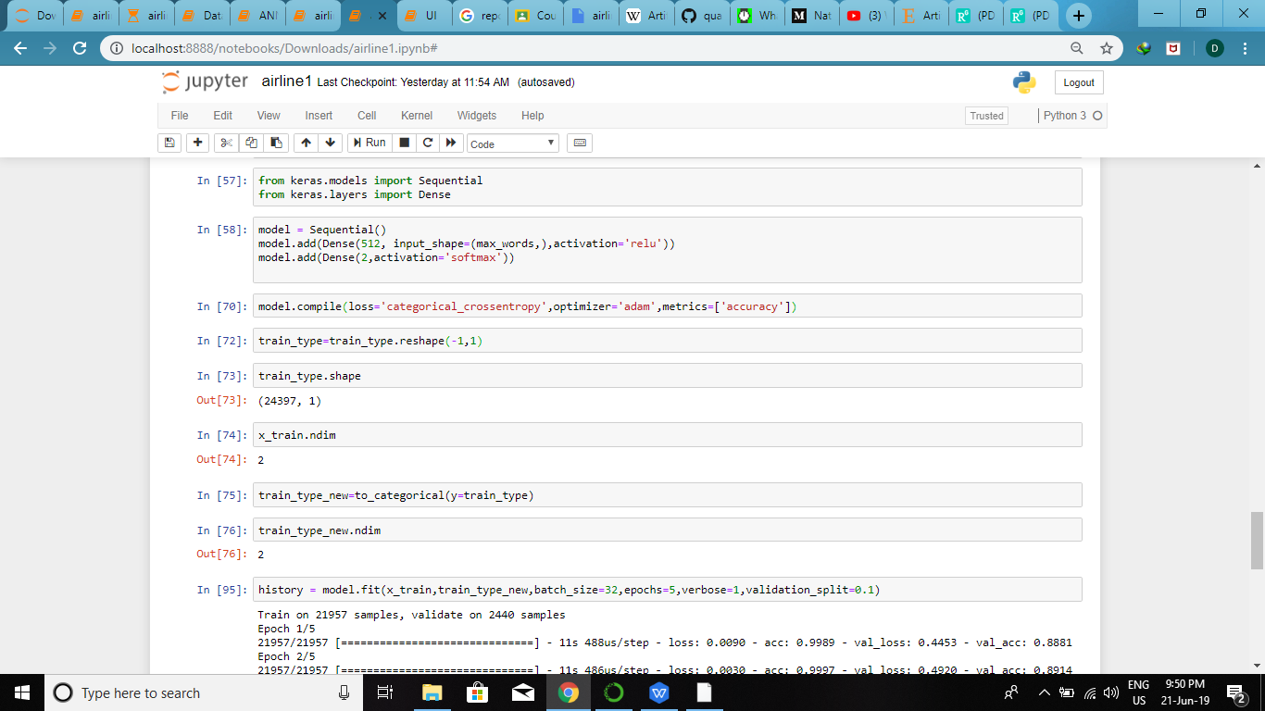
Using Artificial Neural Networks:
Artificial Neural Network (ANN) are a powerful paradigm in machine learning inspired by the computation and communication capabilities of the brain. As such they have been the basis for many powerful algorithms with applications in pattern recognition, memory, mapping, etc.

Slide 8
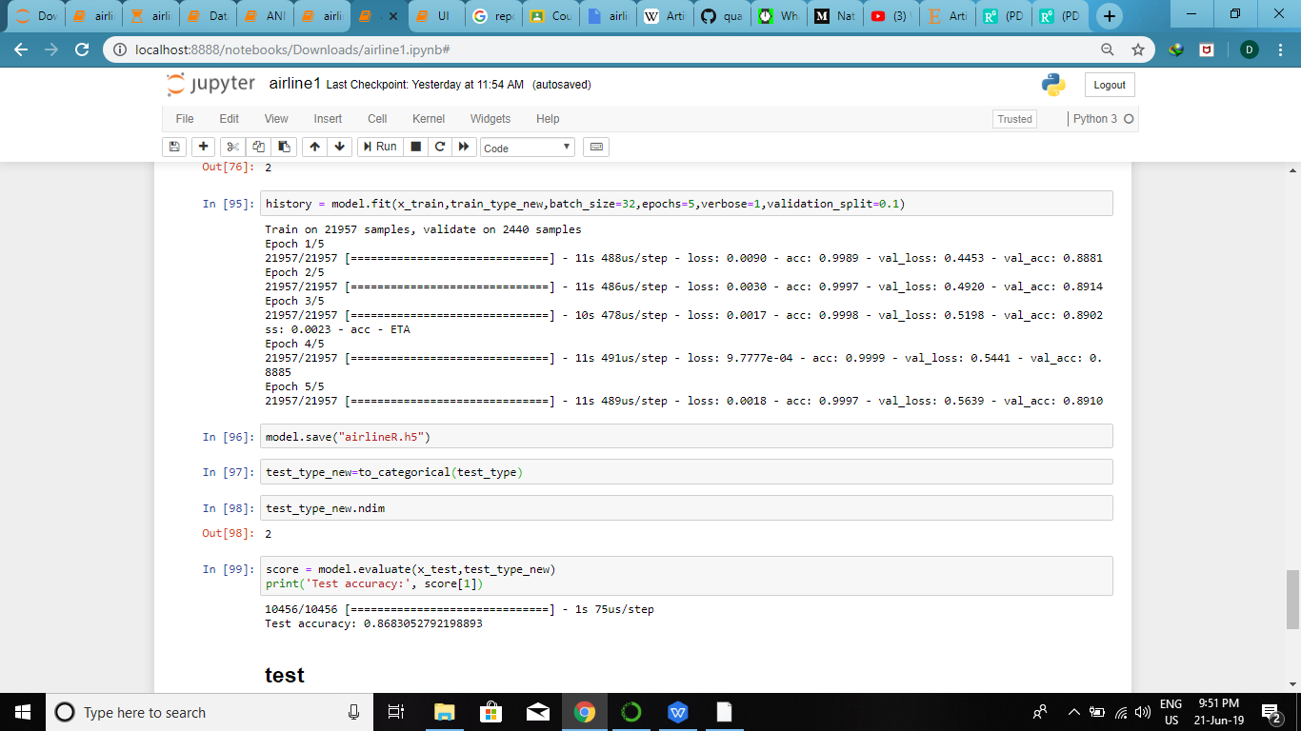
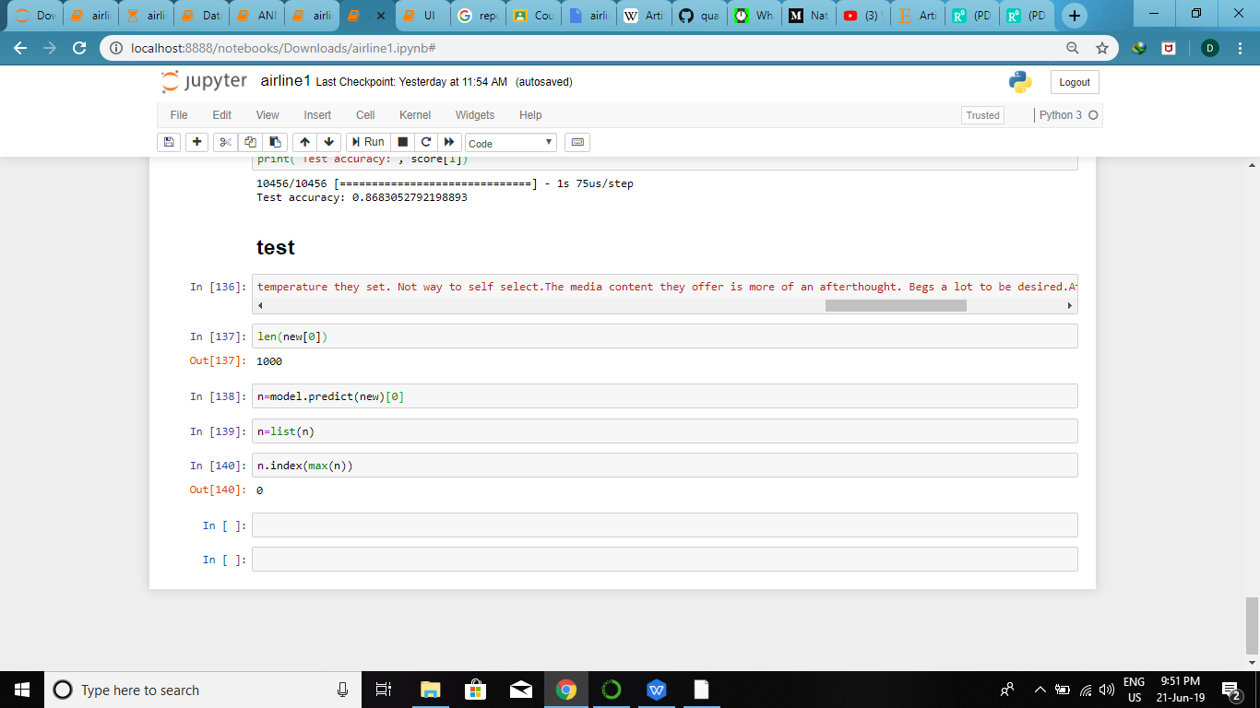
Using Artificial Neural Networks:

Slide 9
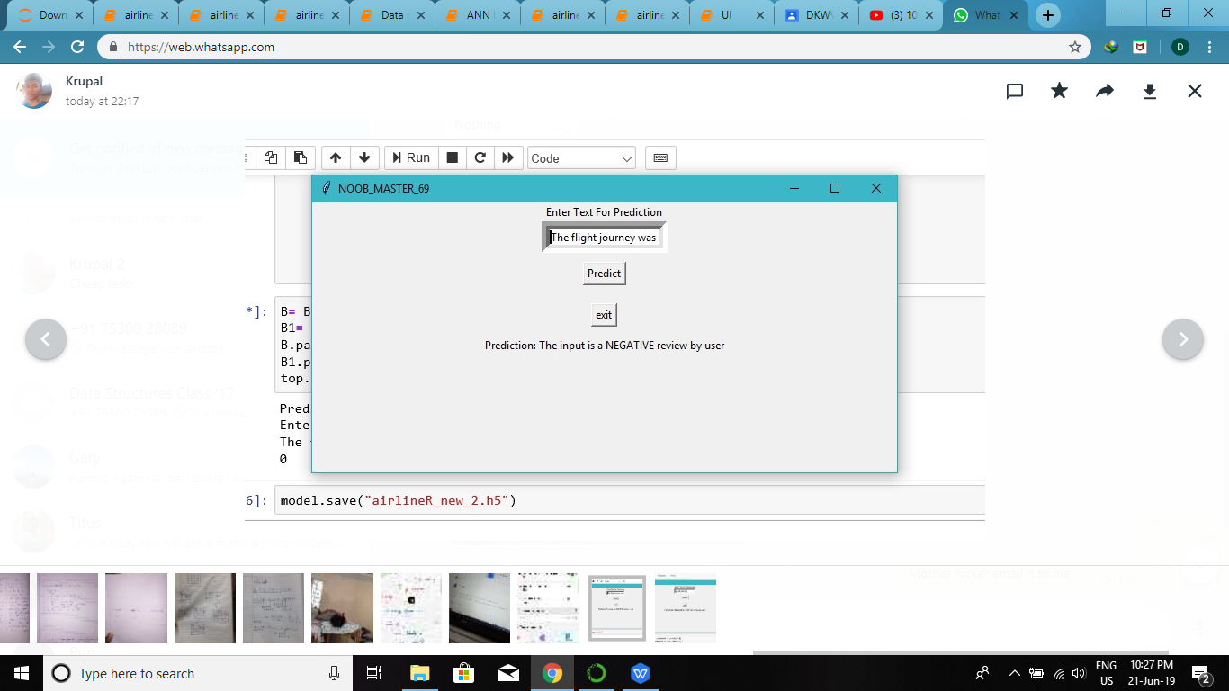
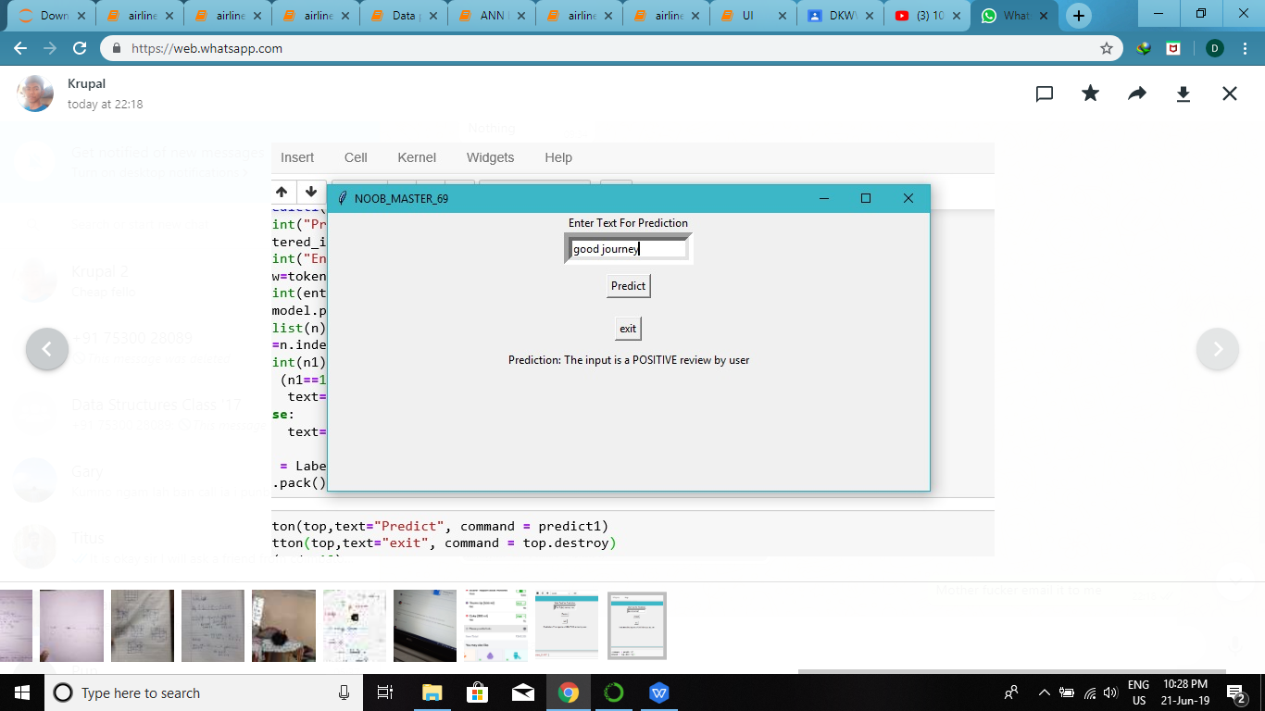
UI implementation using tkinter library:

Slide 10
Conclusion
It is completely possible to use only raw text as input for making predictions. The most important thing is to be able to extract the relevant features from this raw source of data. This kind of data can often come as a good complementary source in data science projects in order to extract more learning features and increase the predictive power of the models.

